Slide 1
Website for booking engineers in your local area
Institutional training project
AMIT KUMAR

Slide 2
Project made by
Mr. Amit Kumar,
UID- 20BCS2414
Mr. Priyanshu Sharma UID- 20BCS2402
Chandigarh University, Gharuan
Mohali

Slide 3


Why we need this online booking electrician, plumber and carpenter Application?
To meet the requirements of electrical, carpenter and plumbing services in your local area.
Each day, homeowners encounter numbers of problems associated with their electrical appliances, wooden structures, and water. These may seem minor issues but they lead to major problems if left untreated. Sometimes, people ignore them because they need to spend some time to look for experienced professionals. It doesn't mean they don't want to get rid of these household issues.

Slide 4
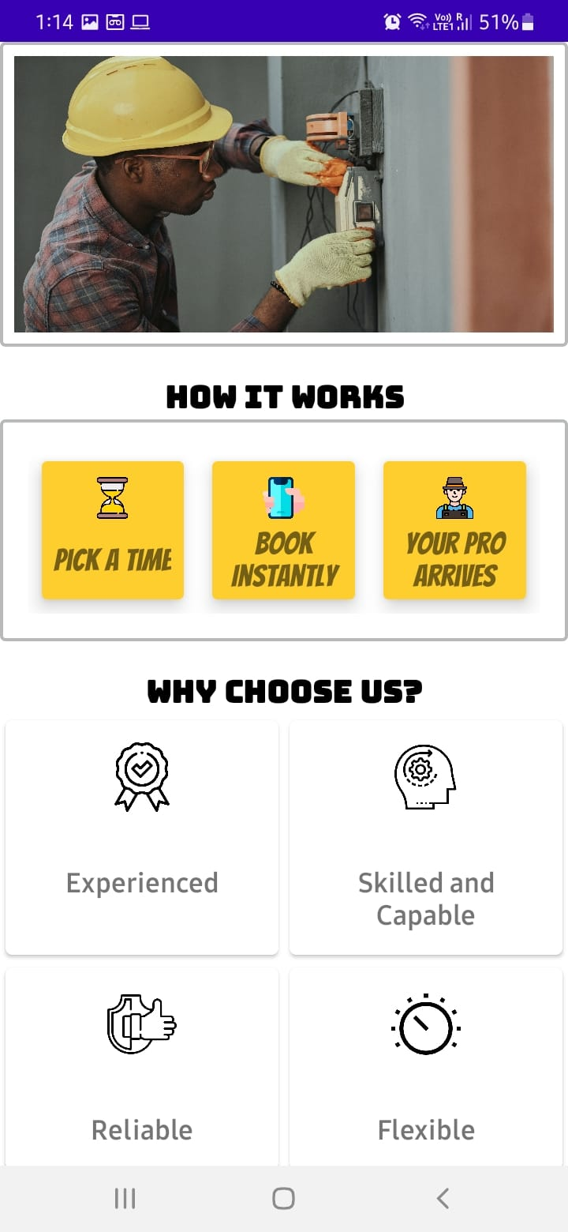
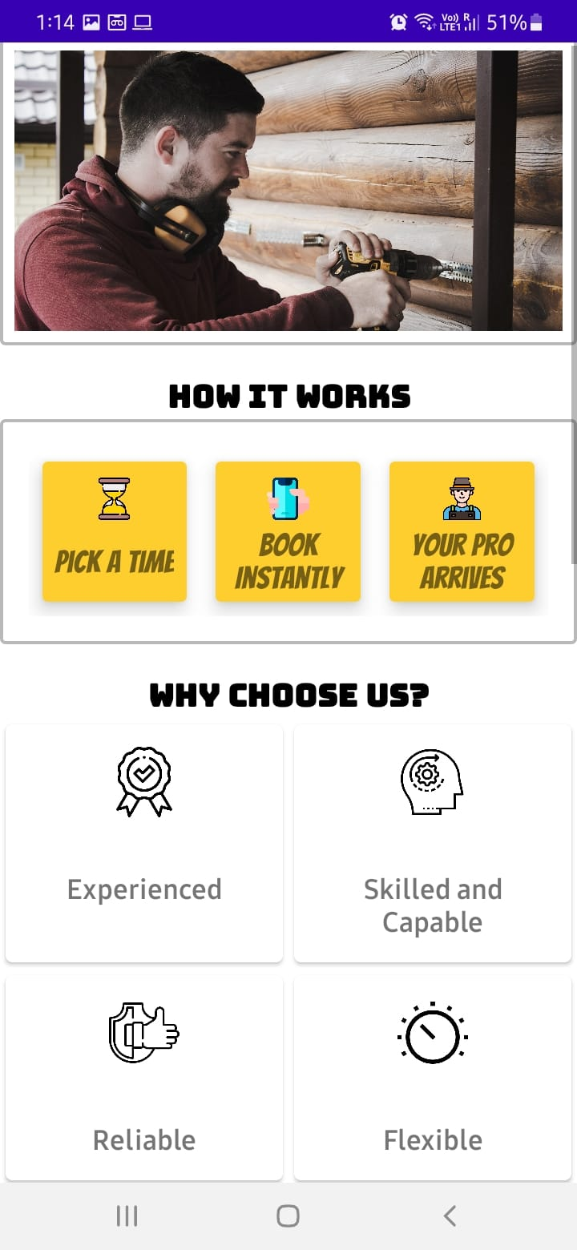
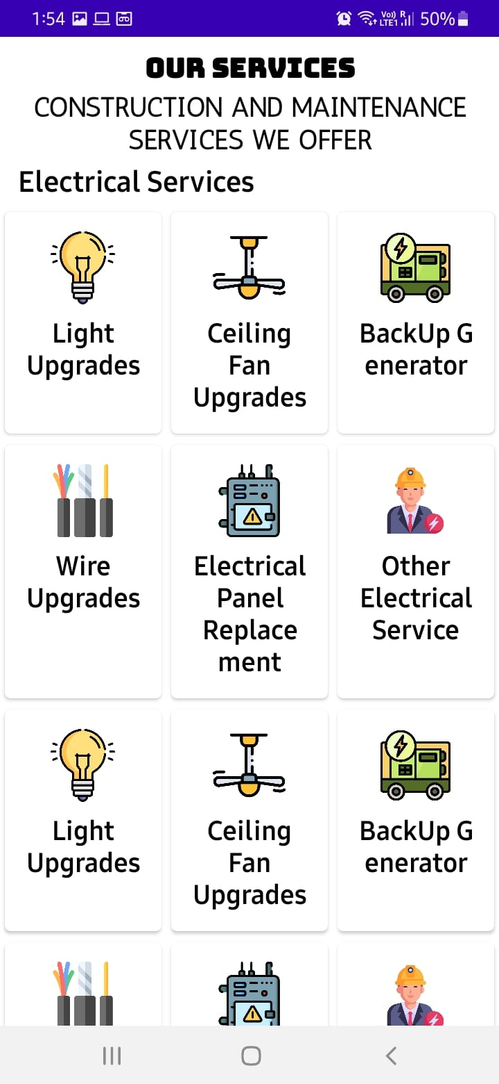
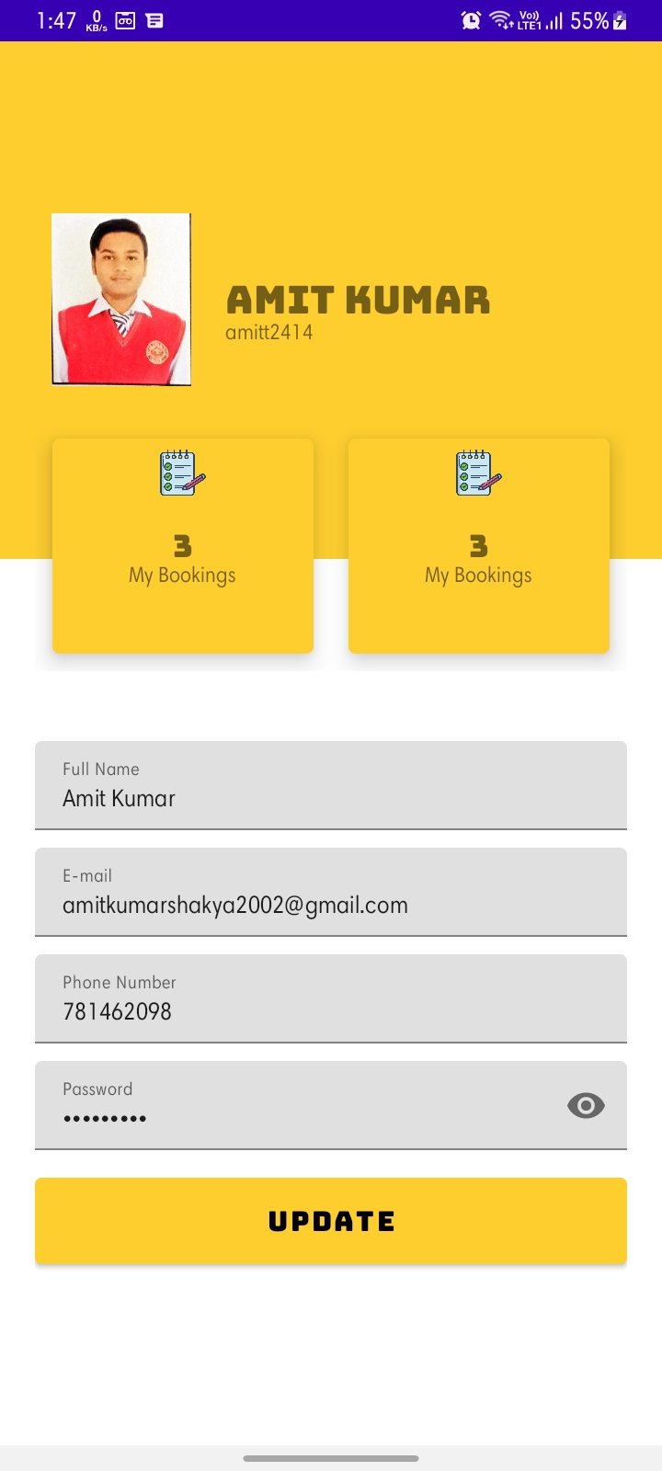
On-demand we made this project for carpenter, electrician, & plumber, and provide people with quick help to resolve household issues associated with electrical appliances, wooden items, and water. An on-demand for plumber, electrician, and carpenter can help find experienced professionals at ease and hire them quickly.
This is the home page of our Application.

Slide 5
System Requirements
Hardware Requirements
SERVER SIDE Minimum Hardware Requirement | Type of device | Android Devices
 | Smart phone | It run Almost 98.77% device
Clint Side Minimum Hardware Requirement | Processor | PC
 | Main Memory | 1 GB Ram
 | HDD | 4 GB

Slide 6
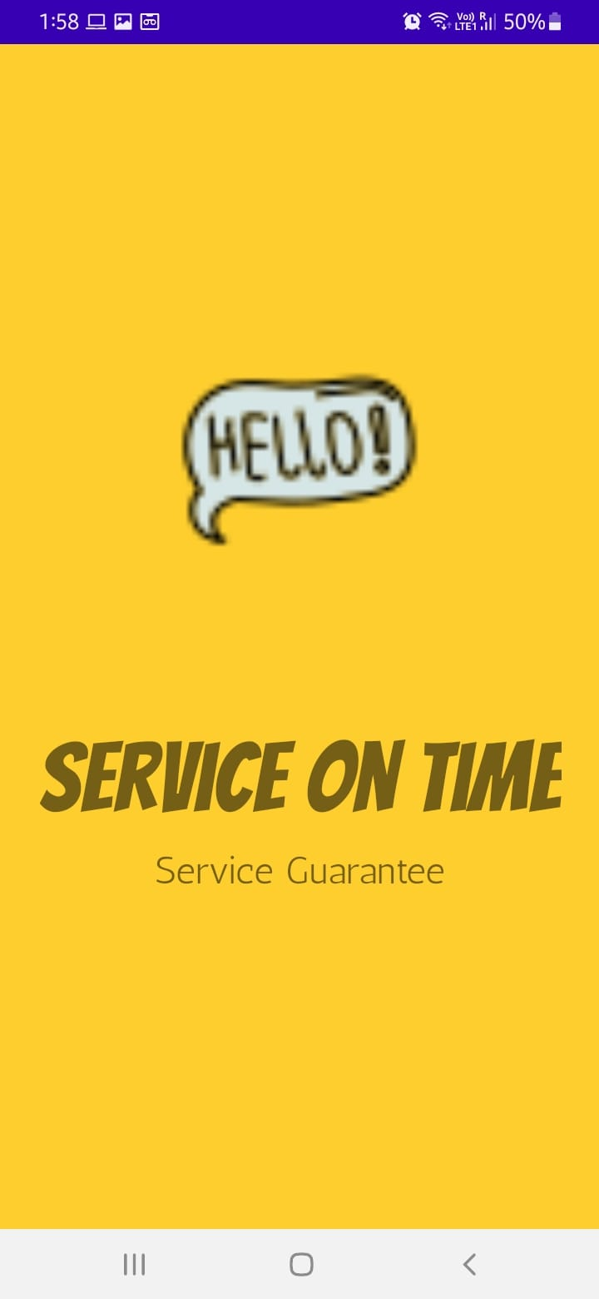
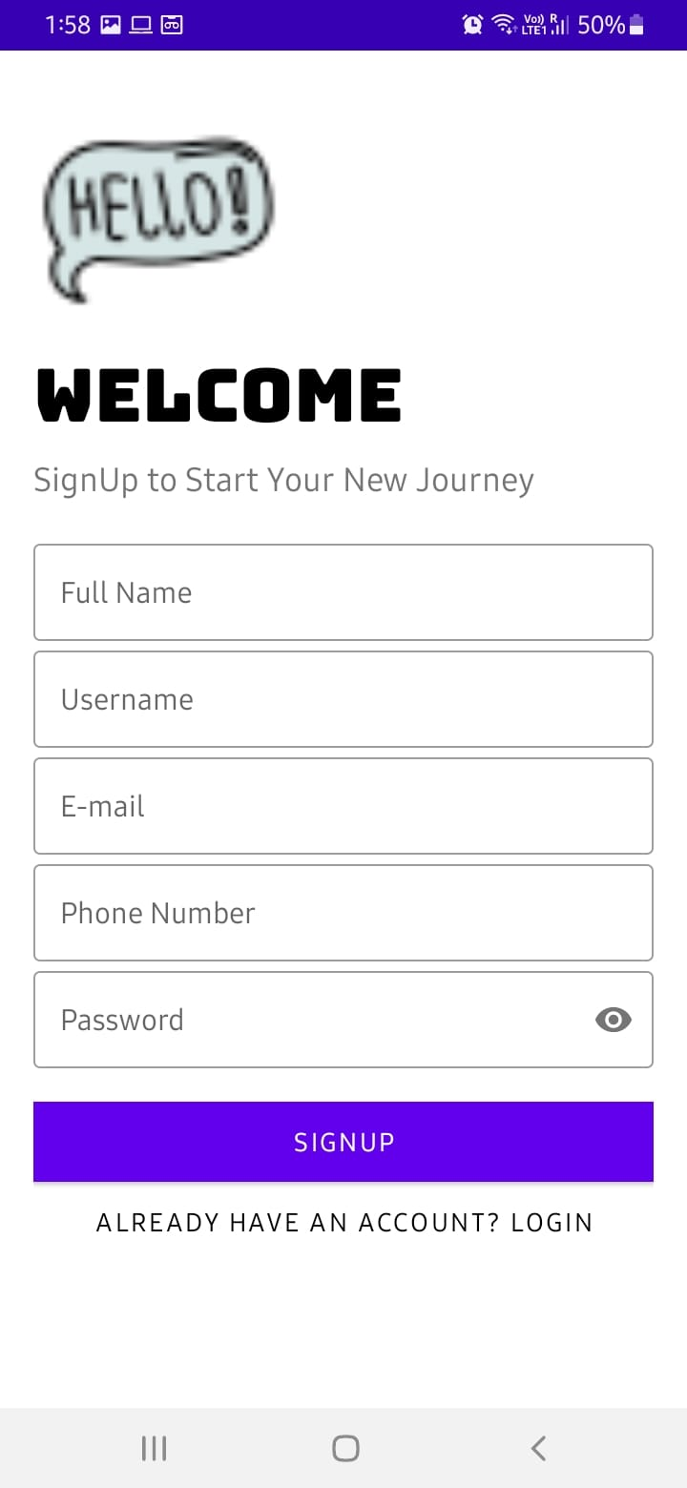
Register/Signup Portal
User can easily make their account to our website

Slide 7
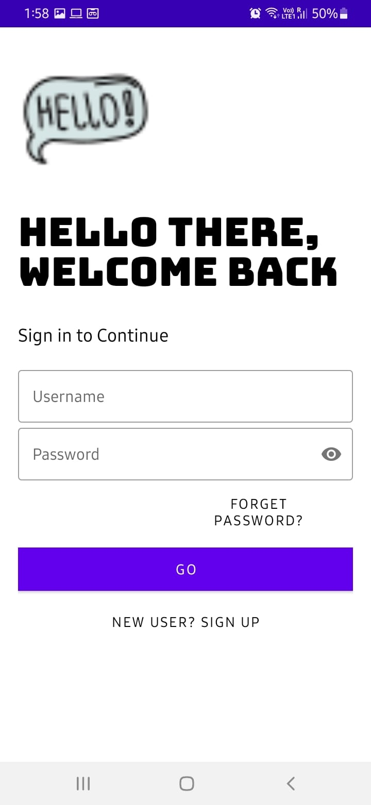
Login Process
After successful registration user can easily login to our website by giving right username and password.

Slide 8
Welcome/Home page
Once the login process done, user will reach to our welcome/home page

Slide 9
Application Overview

Slide 10
Profile
In this page you can see your profile and your booking history and many more .

Slide 11


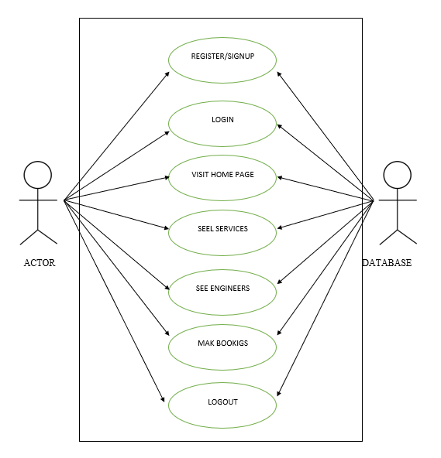
BOOKING SYSTEM

Slide 12
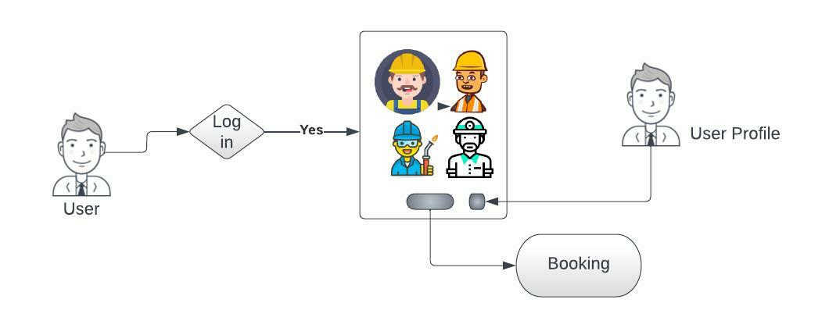
Use Case Diagram:

Slide 13
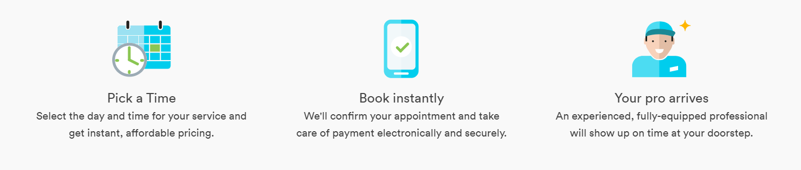
This is how our Applications Work

Slide 14
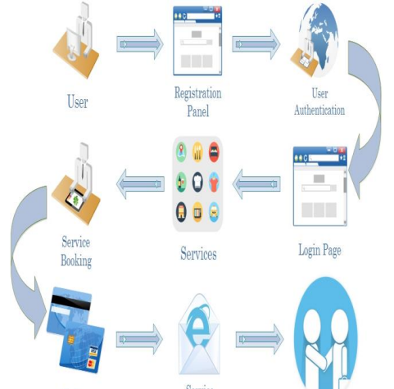
Flow Chart

Slide 15


Happy Customer and Service Provider

Slide 16
All the contents of this project is in this link
https://drive.google.com/drive/folders/1io_RdJaQuOezbPEdSgW0Zof5ZV58tdVY?usp=sharing

Slide 17

Project by- Mr. Amit Kumar
UID- 20BCS2414
INSTITUTIONAL TRAINING PROJECT
JUNE-JULY 2021
CHANDIGARH UNIVERSITY, GHARUAN,
MOHALI

